Slide 1

Accenture Tech Acquisition Analysis
An in-depth examination of Accenture's tech acquisitions from 2020 to 2025 and their effect on its competitive strategy.
AI-Generated Presentation • Confidential

Slide 2
Executive Summary
1
2
3
4
5
Acquisition Strategy
Investment
AI and Digital Transformation
Global Leadership
Talent Development
Disciplined approach with 326 acquisitions from 2020 to 2025
$6.6 billion invested in FY24 alone
Expanded capabilities in AI, digital transformation, and cybersecurity
Accelerated global leadership in technology services
Advanced large-scale AI talent development through investments in learning platforms
2

Slide 3

Market Trends
1
Increasing demand for AI, digital transformation, and cybersecurity solutions
Strategic Context and Evolution of Accenture’s Acquisition Framework
Competitive Landscape
2
Accenture's position in the market and competitive strategy
Acquisition Framework
3
Evolution of Accenture's acquisition framework and approach
Leadership
4
Role of leadership in driving the acquisition strategy
Culture
5
Impact of acquisitions on Accenture's culture and organization
3

Slide 4
Acquisition Trends and Patterns (2020–2025)
TOTAL ACQUISITIONS
INVESTMENT
FOCUS DOMAINS
GROWTH RATE
326
$6.6 billion
AI, digital transformation, cybersecurity, infrastructure, and learning
7%
completed from 2020 to 2025
invested in FY24 alone
key areas of focus
annual growth rate of acquisitions
4

Slide 5
Major Acquisitions by Domain
Acquired Halfspace and CyberCX to expand cybersecurity capabilities
Acquired Yumemi to expand design engineering capabilities
2020
2023
2025
Began aggressive AI acquisition push
2022
Acquired Altus Consulting to enhance financial services capabilities
2024
Continued to invest in learning platforms and AI talent development
5

Slide 6
Integration Outcomes and Organizational Realignment
AI
Digital Transformation
Cybersecurity
Learning
Integrated AI capabilities to enhance service offerings
Realigned organization to support digital transformation initiatives
Enhanced cybersecurity capabilities through acquisitions
Developed large-scale AI talent development programs
6

Slide 7
Accenture Acquisition Volume and Investment by Fiscal Year
FISCAL YEAR
NUMBER OF ACQUISITIONS
INVESTMENT (USD BILLION)
FOCUS DOMAINS
2020
34
1.5
Mixed (incl. AI, cloud, cybersecurity) 8
2021
46
4.2
Broad digital, AI, infrastructure 8
2024
46
6.6
Digital, AI, cloud, industry-specific 9
2025 (to date)
10
N/A
AI, learning, engineering, infrastructure 2
4 records · 4 metrics · Source: Document Analysis
7

Slide 8
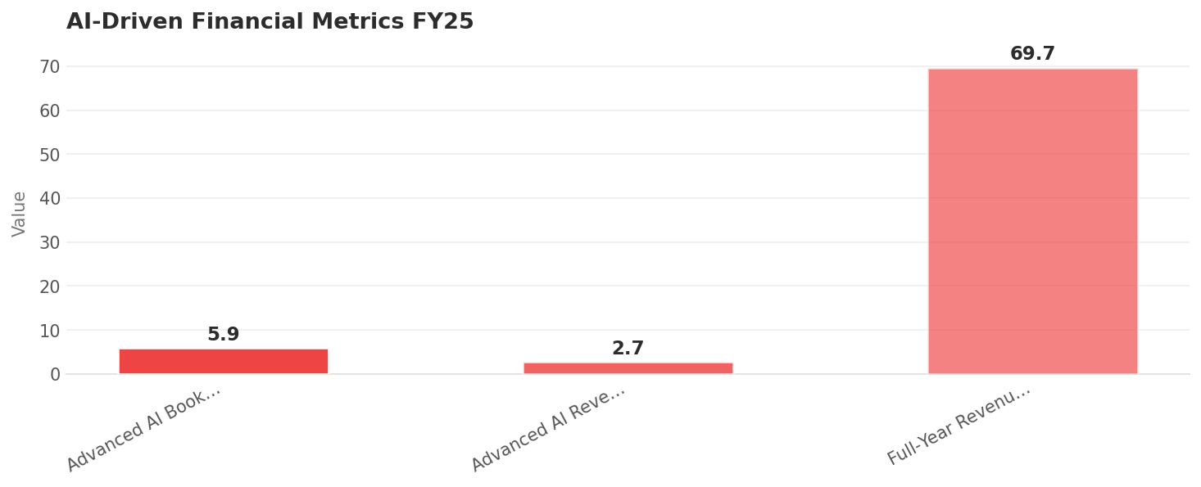
AI-Driven Financial Metrics FY25
Data visualization from document analysis
📊
8

Slide 9
Forward-Looking Acquisition Opportunities
01
02
03
04
05
Cloud Services
Data Analytics
Cybersecurity
AI and Machine Learning
Digital Transformation
Opportunity to expand cloud services capabilities
Potential to enhance data analytics capabilities
Continued investment in cybersecurity solutions
Further development of AI and machine learning capabilities
Expansion of digital transformation services
9

Slide 10

Focus on AI and Digital Transformation
1
Continued investment in AI and digital transformation initiatives
Strategic Recommendations for Future Acquisition Strategy
Enhance Cybersecurity Capabilities
2
Further development of cybersecurity solutions
Develop Large-Scale AI Talent
3
Continued investment in large-scale AI talent development programs
Expand Cloud Services
4
Opportunity to expand cloud services capabilities
Monitor Market Trends
5
Continuous monitoring of market trends and competitor activity
10

Slide 11
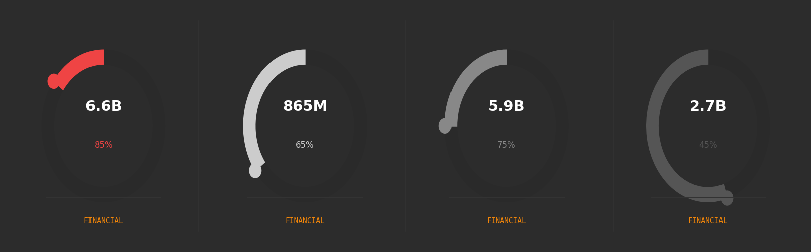
Key Metrics and Performance Indicators
11

Slide 12

Accenture's Tech Acquisition Strategy
Defining Moment: Accenture's tech acquisition strategy has been a defining moment in its history
AI: $865 million
Digital Transformation: $5.9 billion
Cybersecurity: $2.7 billion
12

Slide 13

Conclusion
→
Accenture's tech acquisition strategy has been highly successful
→
AI and digital transformation have been key areas of focus
→
Cybersecurity and cloud services are opportunities for future growth
→
Large-scale AI talent development is critical for future success
→
Continuous monitoring of market trends and competitor activity is essential
13

